Slide 1


Unit 7
Tracking progress towards survey completion
Notes:
Welcome to Unit 7 of Module 4.

Slide 2
By the end of this unit, you will be able to:
describe the CSPro application tasks for the supervisor to track progress towards survey completion
Notes:
By the end of this unit, you will be able to:​
​
describe the CSPro application tasks for the supervisor to track progress towards survey completion.

Slide 3
Tracking progress towards survey completion
No. | Who? | What? | When?
1 | Supervisor | Select sections for validation | Before arrival at facility
2 | Supervisor | Validate facility data | At facility
3 | Supervisor | Sync validation data | End of the day
4 | Supervisor | Download all data | As needed
5 | Supervisor | View reports | As needed
6 | Supervisor | Update application | As needed
Notes:
In this unit, we will look at the tasks that the supervisor needs to carry out to track progress towards survey completion for the teams they supervise using the HHFA CSPro application:​​
​​
“Download all data”; and​​
“View reports”.

Slide 4
4. Download all data
No. | Who? | What? | When?
1 | Supervisor | Select sections for validation | Before arrival at facility
2 | Supervisor | Validate facility data | At facility
3 | Supervisor | Sync validation data | End of the day
4 | Supervisor | Download all data | As needed
5 | Supervisor | View reports | As needed
6 | Supervisor | Update application | As needed
Notes:
To track progress towards survey completion, the first thing the supervisor needs to do is to download all the data from the server.

Slide 5

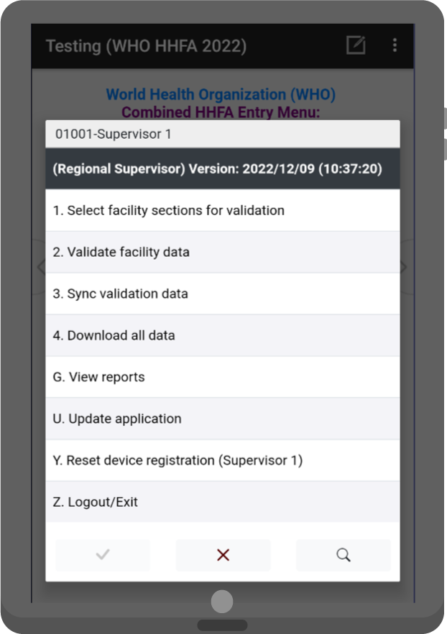
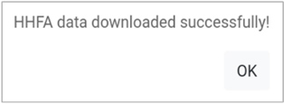
4. Download all data
The supervisor needs to download all data from the server to generate and view reports on facility coverage.
Notes:
The supervisor needs to download all data from the server to generate and view reports on facility coverage.​
​
To download all data, the supervisor needs to select the “Download all data” option from the main menu.​
​
If data is downloaded successfully, the message “HHFA data downloaded successfully!” will appear and the application will return to the main menu.

Slide 6
5. View reports
No. | Who? | What? | When?
1 | Supervisor | Select sections for validation | Before arrival at facility
2 | Supervisor | Validate facility data | At facility
3 | Supervisor | Sync validation data | End of the day
4 | Supervisor | Download all data | As needed
5 | Supervisor | View reports | As needed
6 | Supervisor | Update application | As needed
Notes:
Once all the data has been downloaded, the supervisor can proceed to generate and view reports.

Slide 7
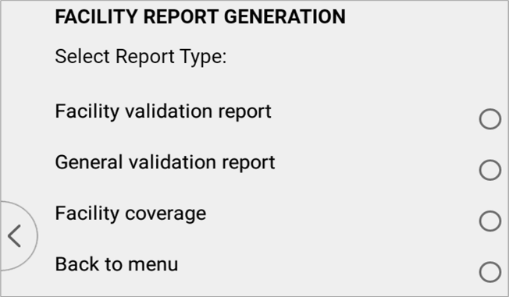
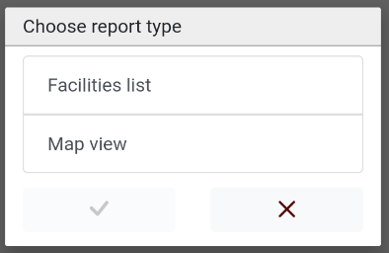
5. View reports
The supervisor can generate 2 types of facility coverage reports to track the progress of data collection by teams.
Notes:
The supervisor can generate 2 types of facility coverage reports to track the progress of data collection by teams.​
​
To generate reports, the supervisor needs to:​
​
first, select the “Download all data” option from the main menu;​
then, select the “View reports” option from the main menu;​
next, select “Facility coverage,”; and​
then choose the report type, either:​
“Facilities list”; or​
“Map view”, depending on whether the supervisor wants to see the facilities covered by their respective teams as a list or as a map.

Slide 8
5. View reports
To view a list of the facilities, the supervisor chooses “Facilities list”.
Notes:
If the supervisor wants to view a list of the facilities, they need to choose "Facilities list".

Slide 9
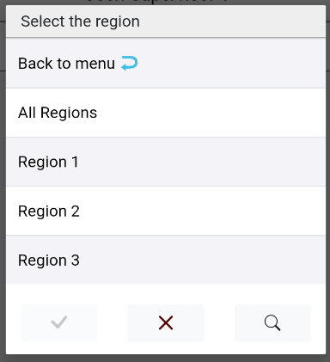
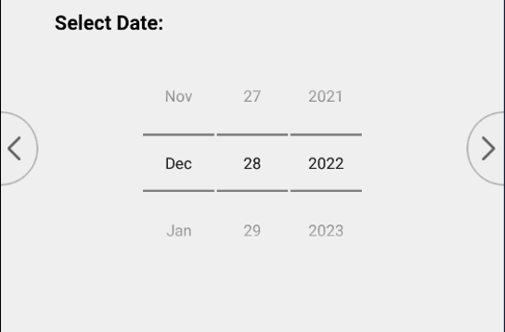
5. View reports
Facility coverage report – List view (ALL REGIONS on a date)
Notes:
This functionality allows the supervisor to create a custom report based on the following 3 query criteria:​
​
report of the facilities in all regions visited by teams on a specified date;

Slide 10
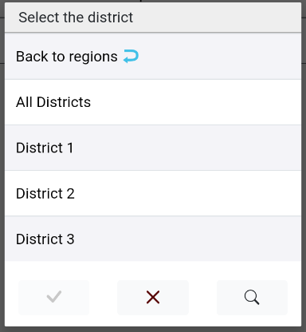
5. View reports
Facility coverage review – List view (SPECIFIC REGION on a date)
Notes:
report of the facilities in a specific region, including all districts in the region visited by teams on a specified date;

Slide 11
5. View reports
Facility coverage review – List view (SPECIFIC DISTRICT on a date)
Notes:
report of the facilities in a specific region in a specific district visited by teams on a specified date. ​
​
The report filters facilities based on one of the 3 query criteria. ​
​
The report will only show the facilities surveyed by the data collection teams that are under a specific supervisor.

Slide 12
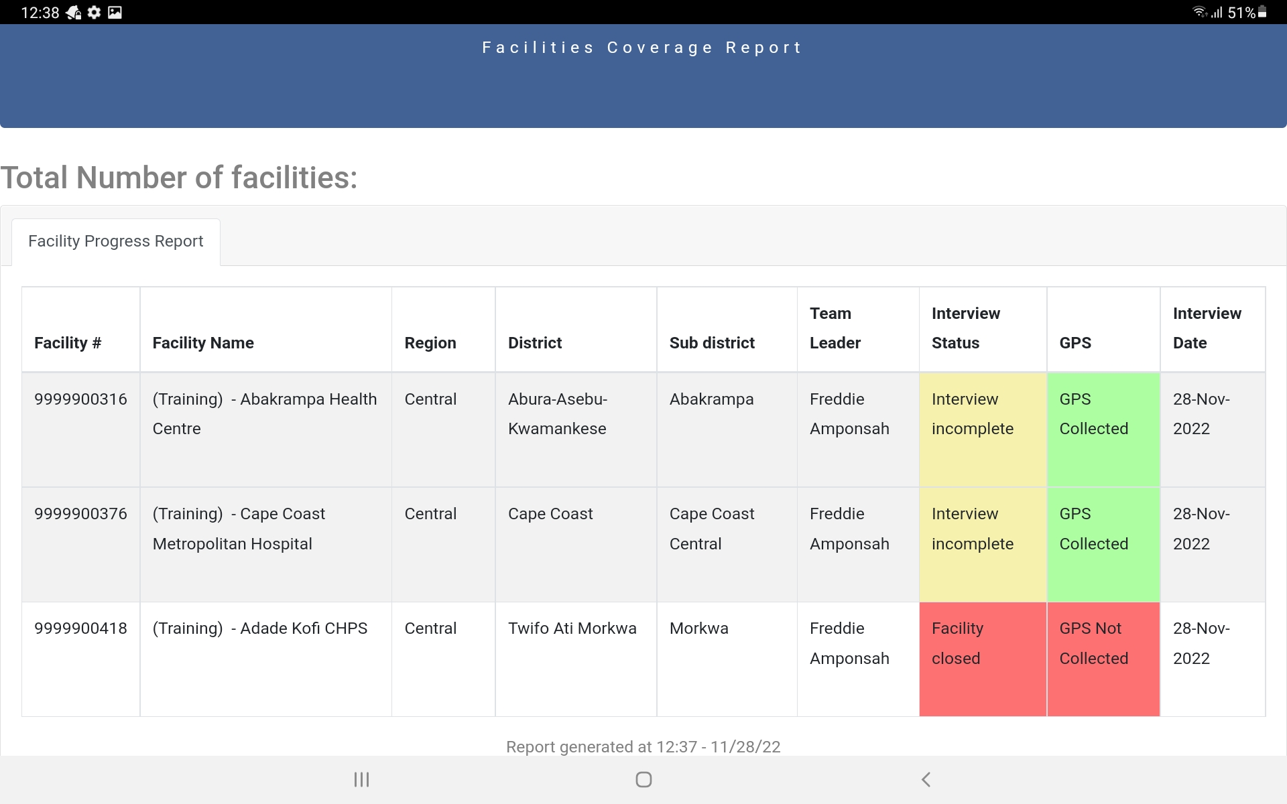
5. View reports
Facility coverage review – List view
Notes:
The list view of the facility coverage report provides a list of facilities covered by the respective teams under the supervisor and includes the interview status for each facility. ​

Slide 13



5. View reports
After viewing the facility coverage report, the supervisor should discuss with team leaders to make sure that:
2.
the information on facility completion in the facility coverage report is consistent with the team leaders’ reports
1.
the team is on track with data collection
if not, team leaders must use these functions:
“Create complete record”
“Sync data”
Notes:
After reviewing the facility coverage report, the supervisor should discuss with team leaders to make sure that:​
​
the team is on track with data collection;​
the information on facility completion in the facility coverage report is consistent with the team leaders’ reports. The “Create complete record” function is used to track survey completeness. If team leaders do not create the complete record, the supervisors think data collection is incomplete. If there are discrepancies between the facility completeness reports viewed by the supervisor and team leaders, the supervisor must:​
ask the team leaders to use the “Create complete record” and “Sync data” functions.​

Slide 14
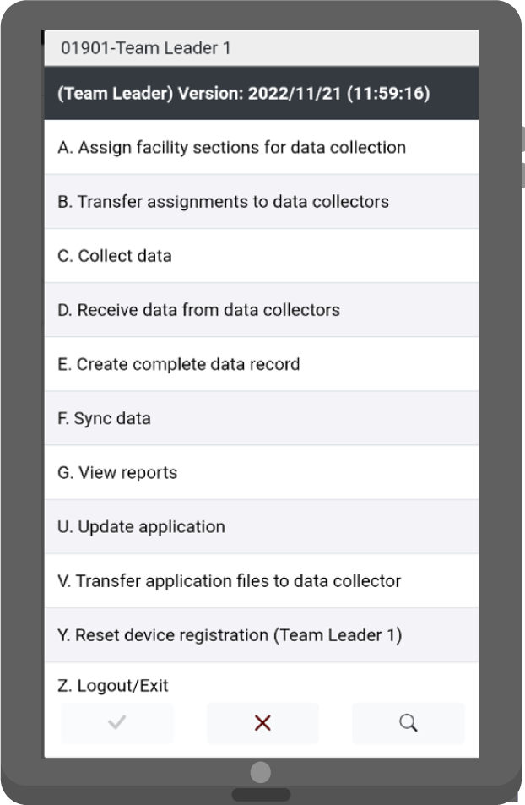
5. View reports
Supervisors should continue to remind team leaders to create the complete facility record and sync data to the server at the end of each day.
Notes:
Supervisors should continue to remind team leaders to create the complete facility record and sync data to the server at the end of each day. This will ensure that the most up-to-date information is available for survey progress monitoring!

Slide 15
5. View reports
To view a map of the facilities, the supervisor selects “Map view”.
Notes:
If the supervisor wants to view a map of the facilities, they need to select “Map view”.

Slide 16
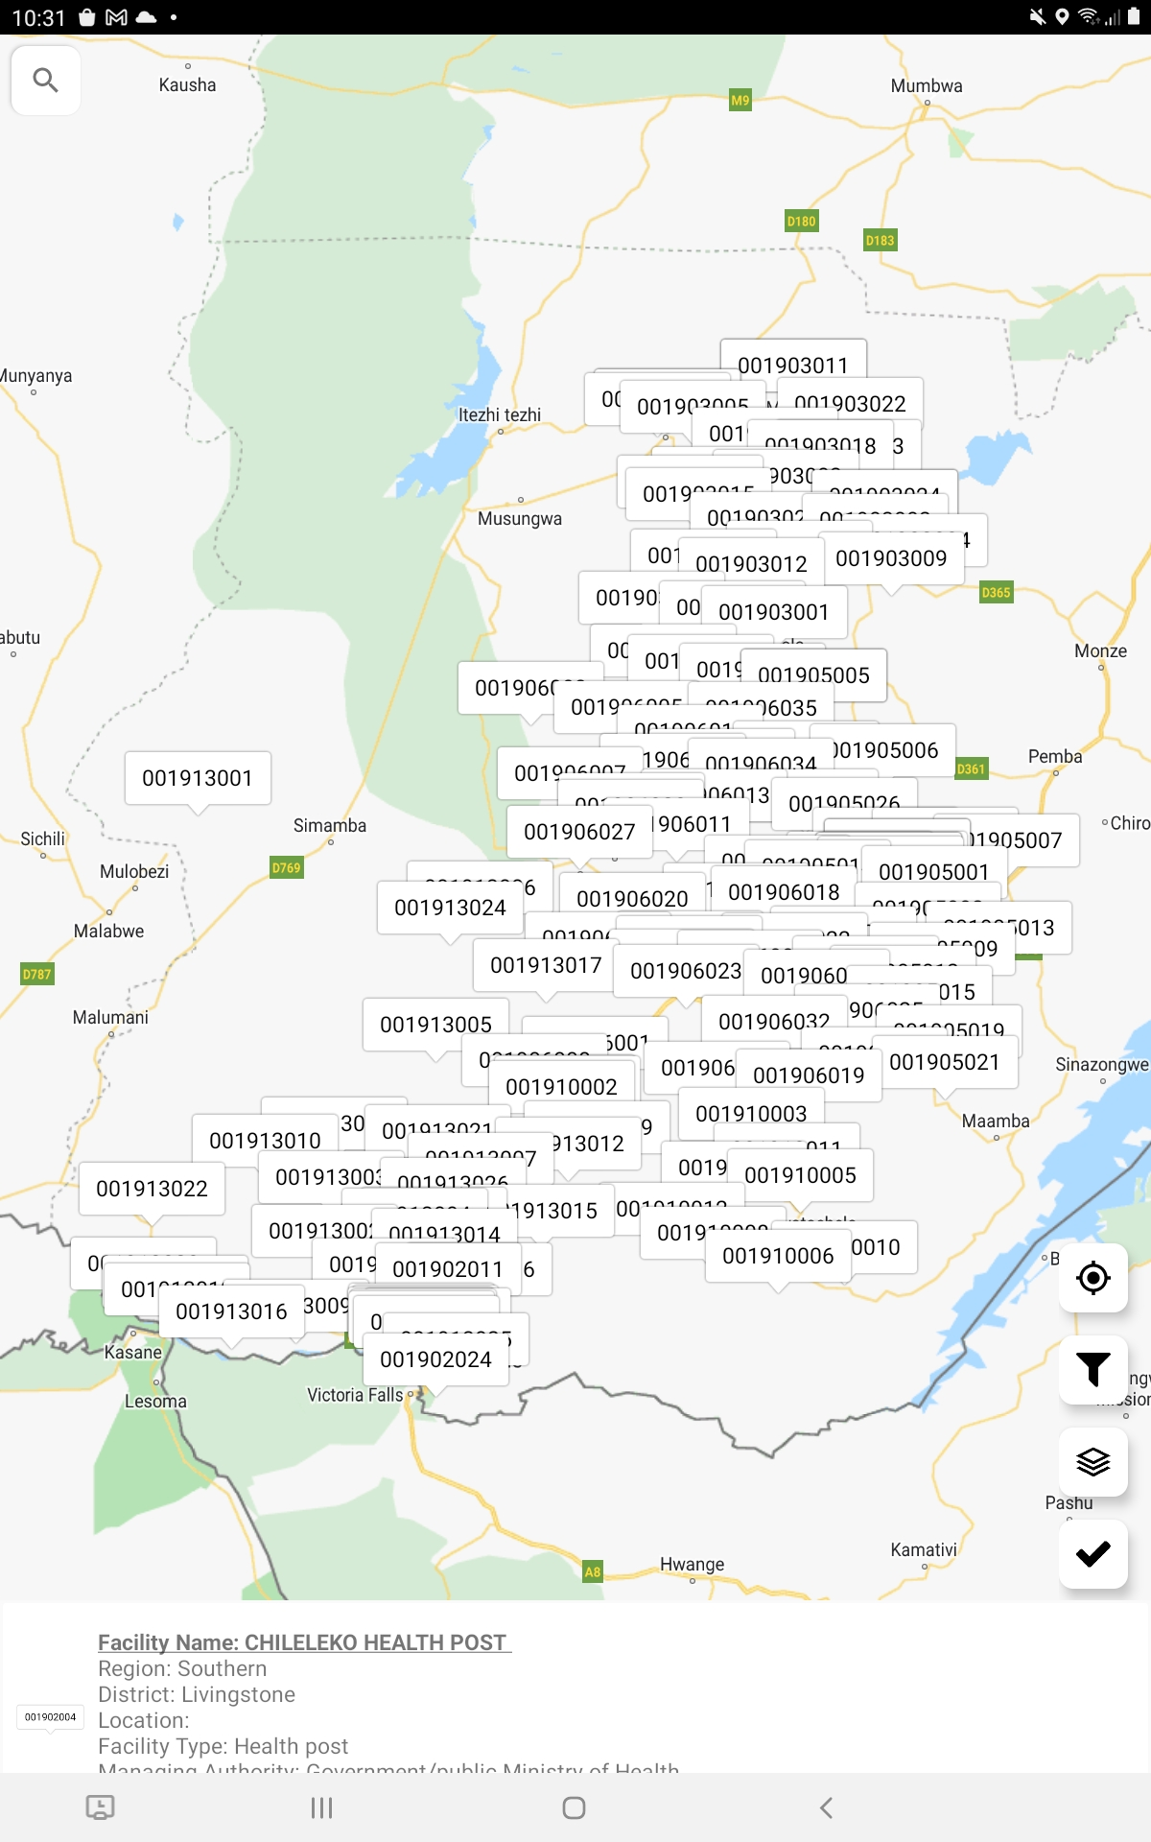
5. View reports
Facility coverage report – Map view
Notes:
The Map view of the facility coverage report shows the exact location of the facilities that the supervisor’s teams have visited and collected data for. ​​
​
Each facility is labelled with the facility code.

Slide 17
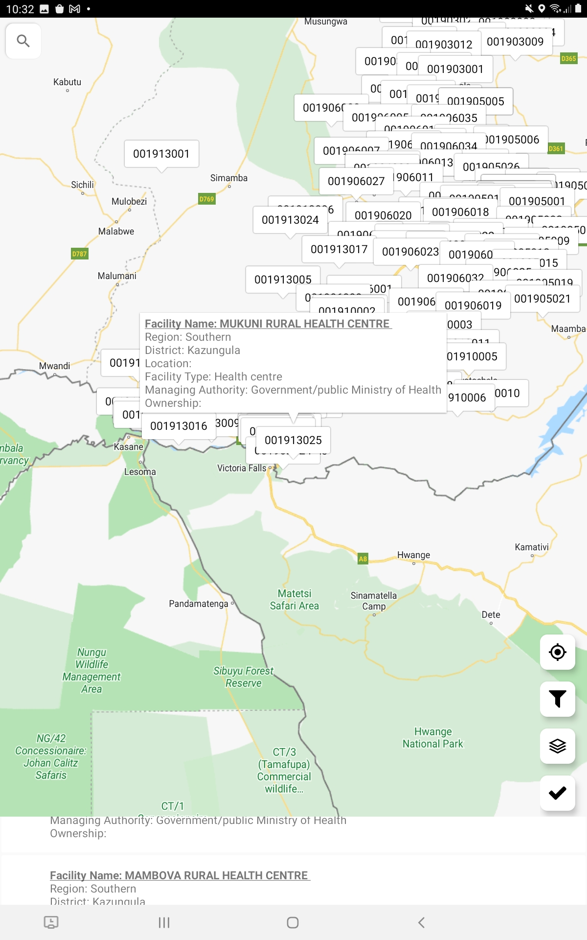
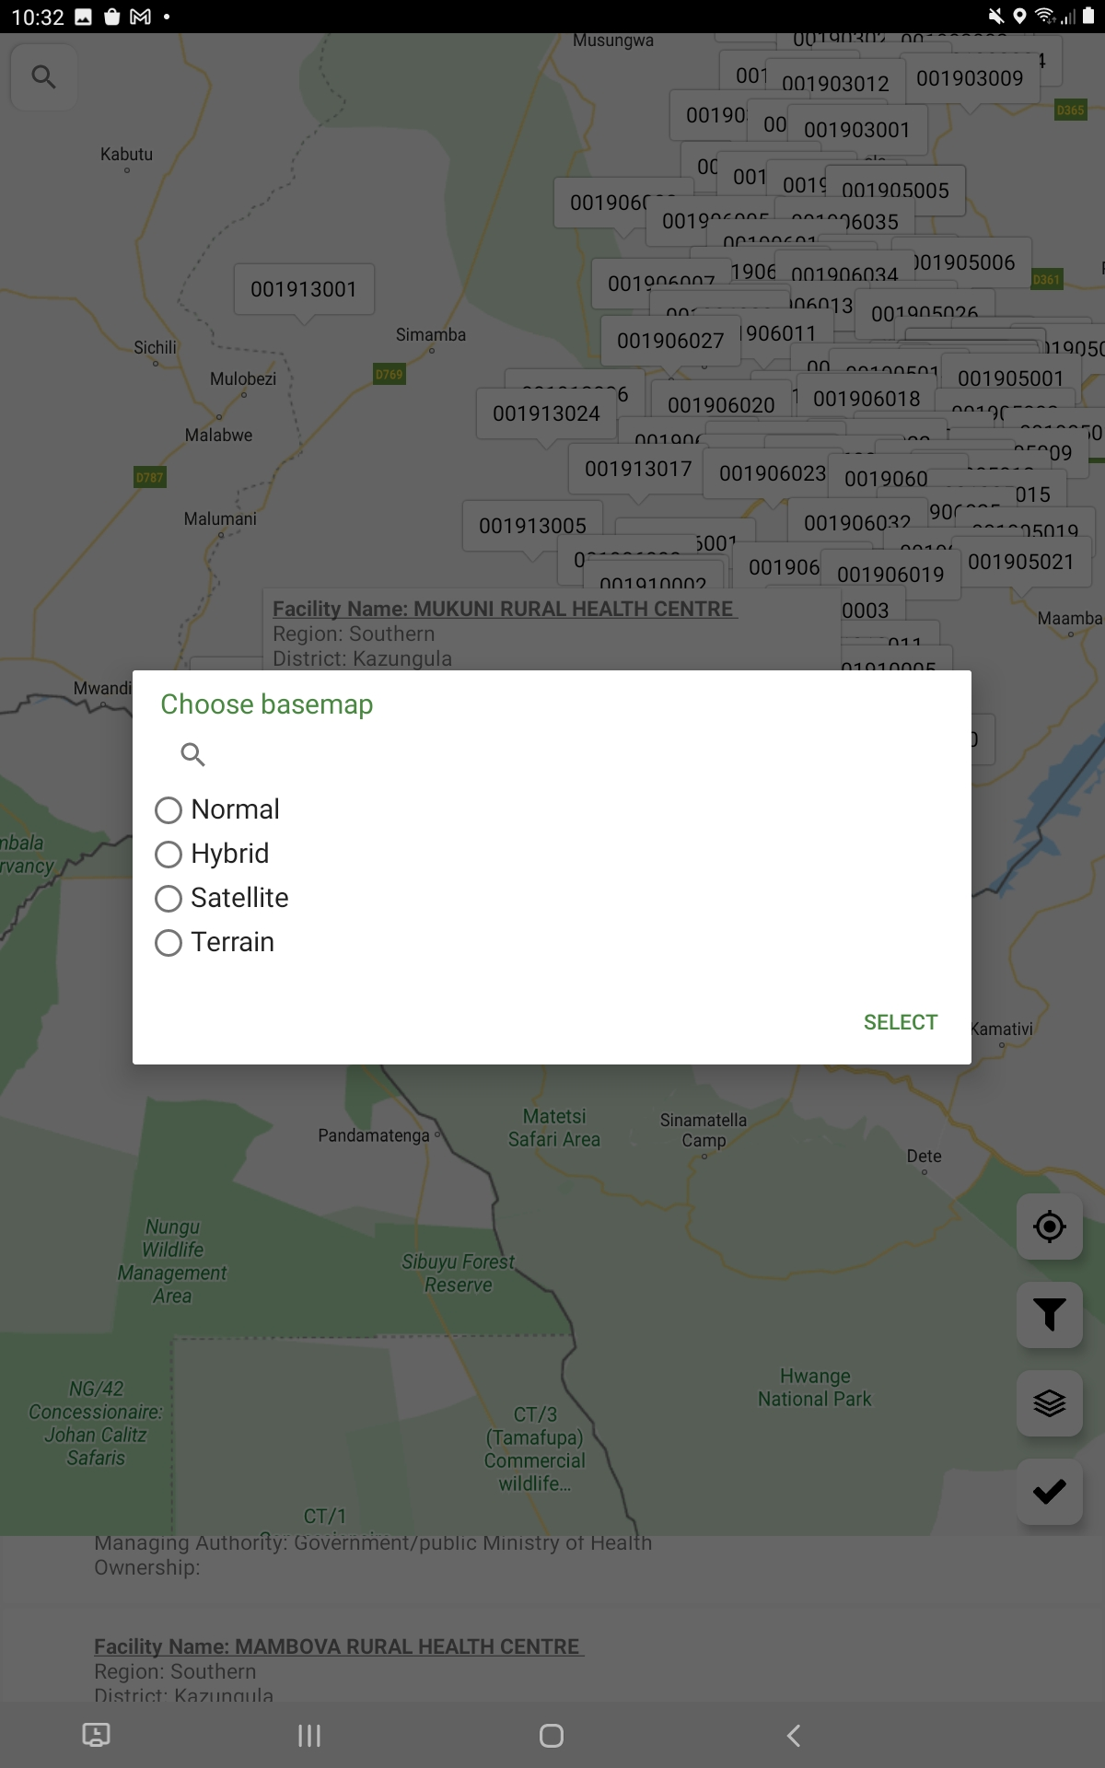
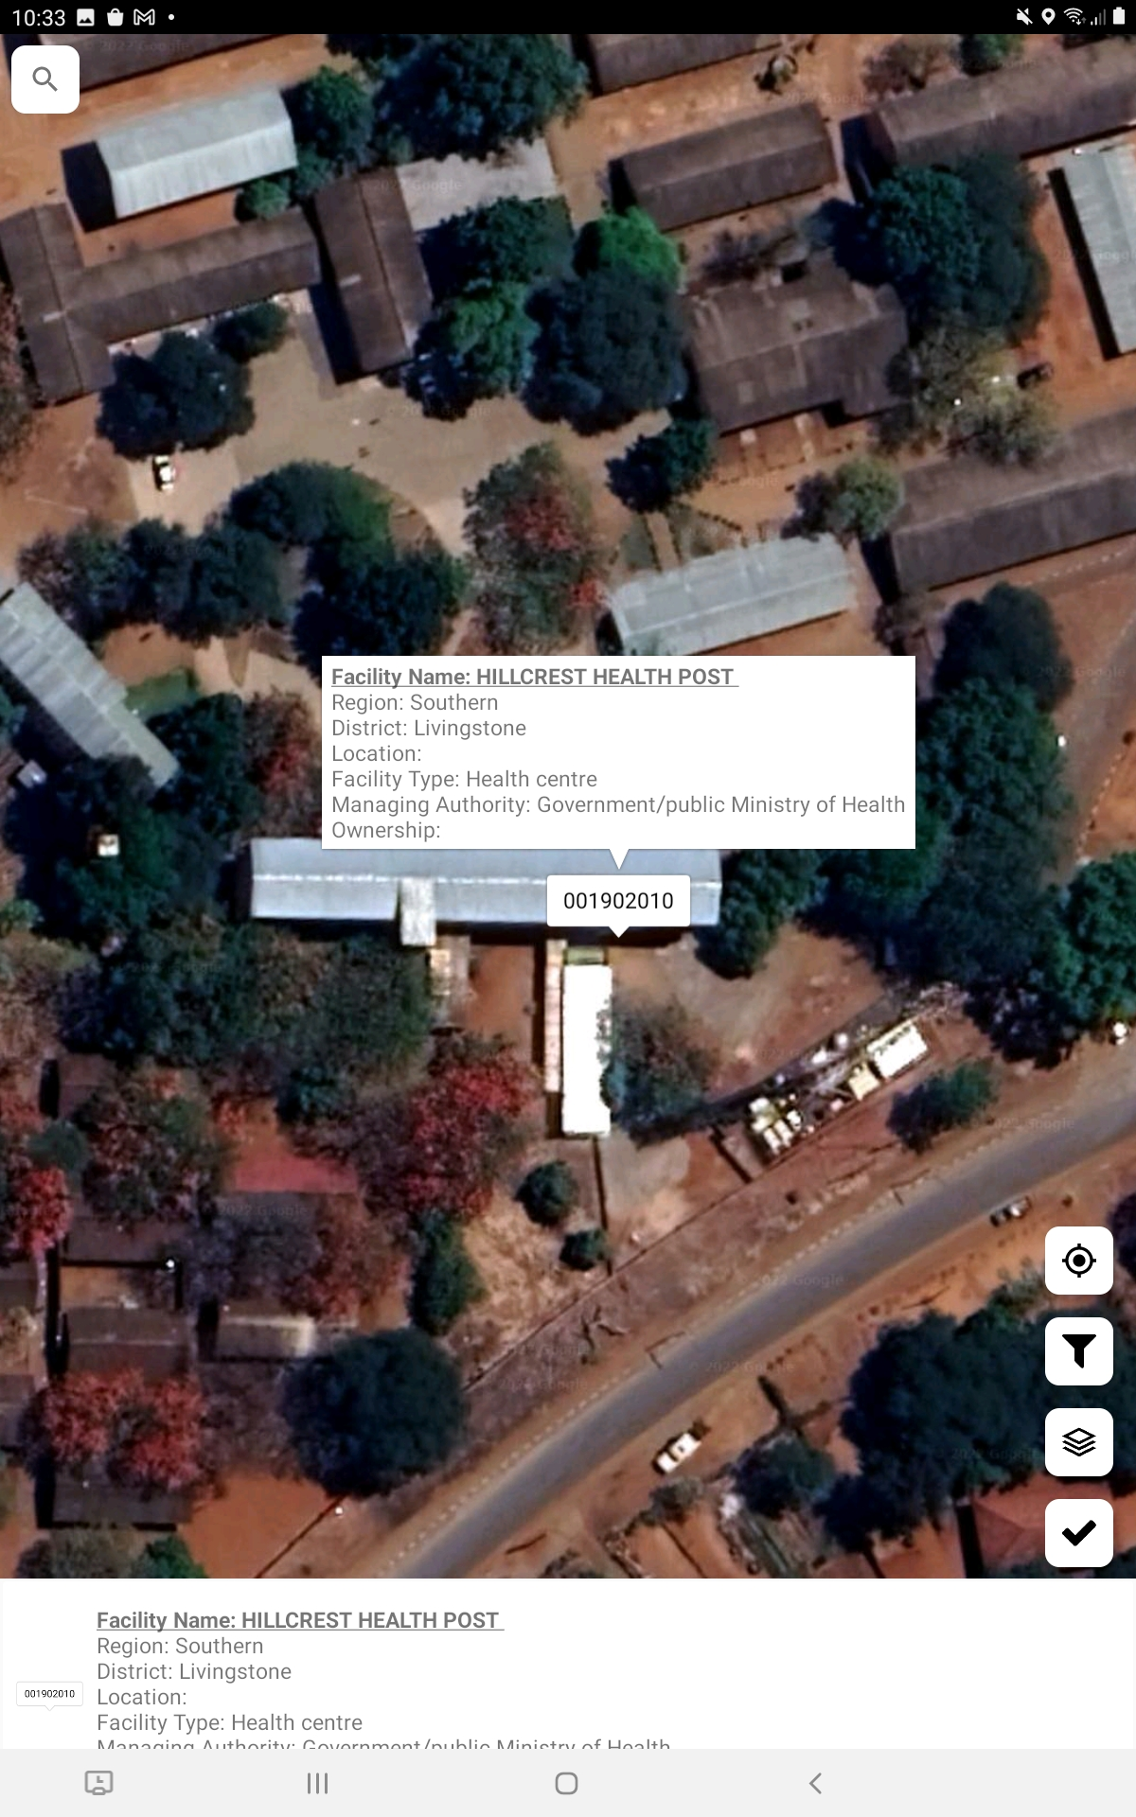
5. View reports
Facility coverage report – Map view
Click on any facility to get key information on that facility
Click on the “basemap” icon to toggle between basemap types
Basemap types include the following:
Example of Satellite view
Notes:
Click on any facility to get key information on that facility.​
​
Click on the “basemap” icon in the red box to toggle between basemap types. ​
​
There are 4 basemap types – normal, hybrid, satellite, and terrain. The default map type is “normal”. ​
​
We can see an example of the satellite view here.

Slide 18
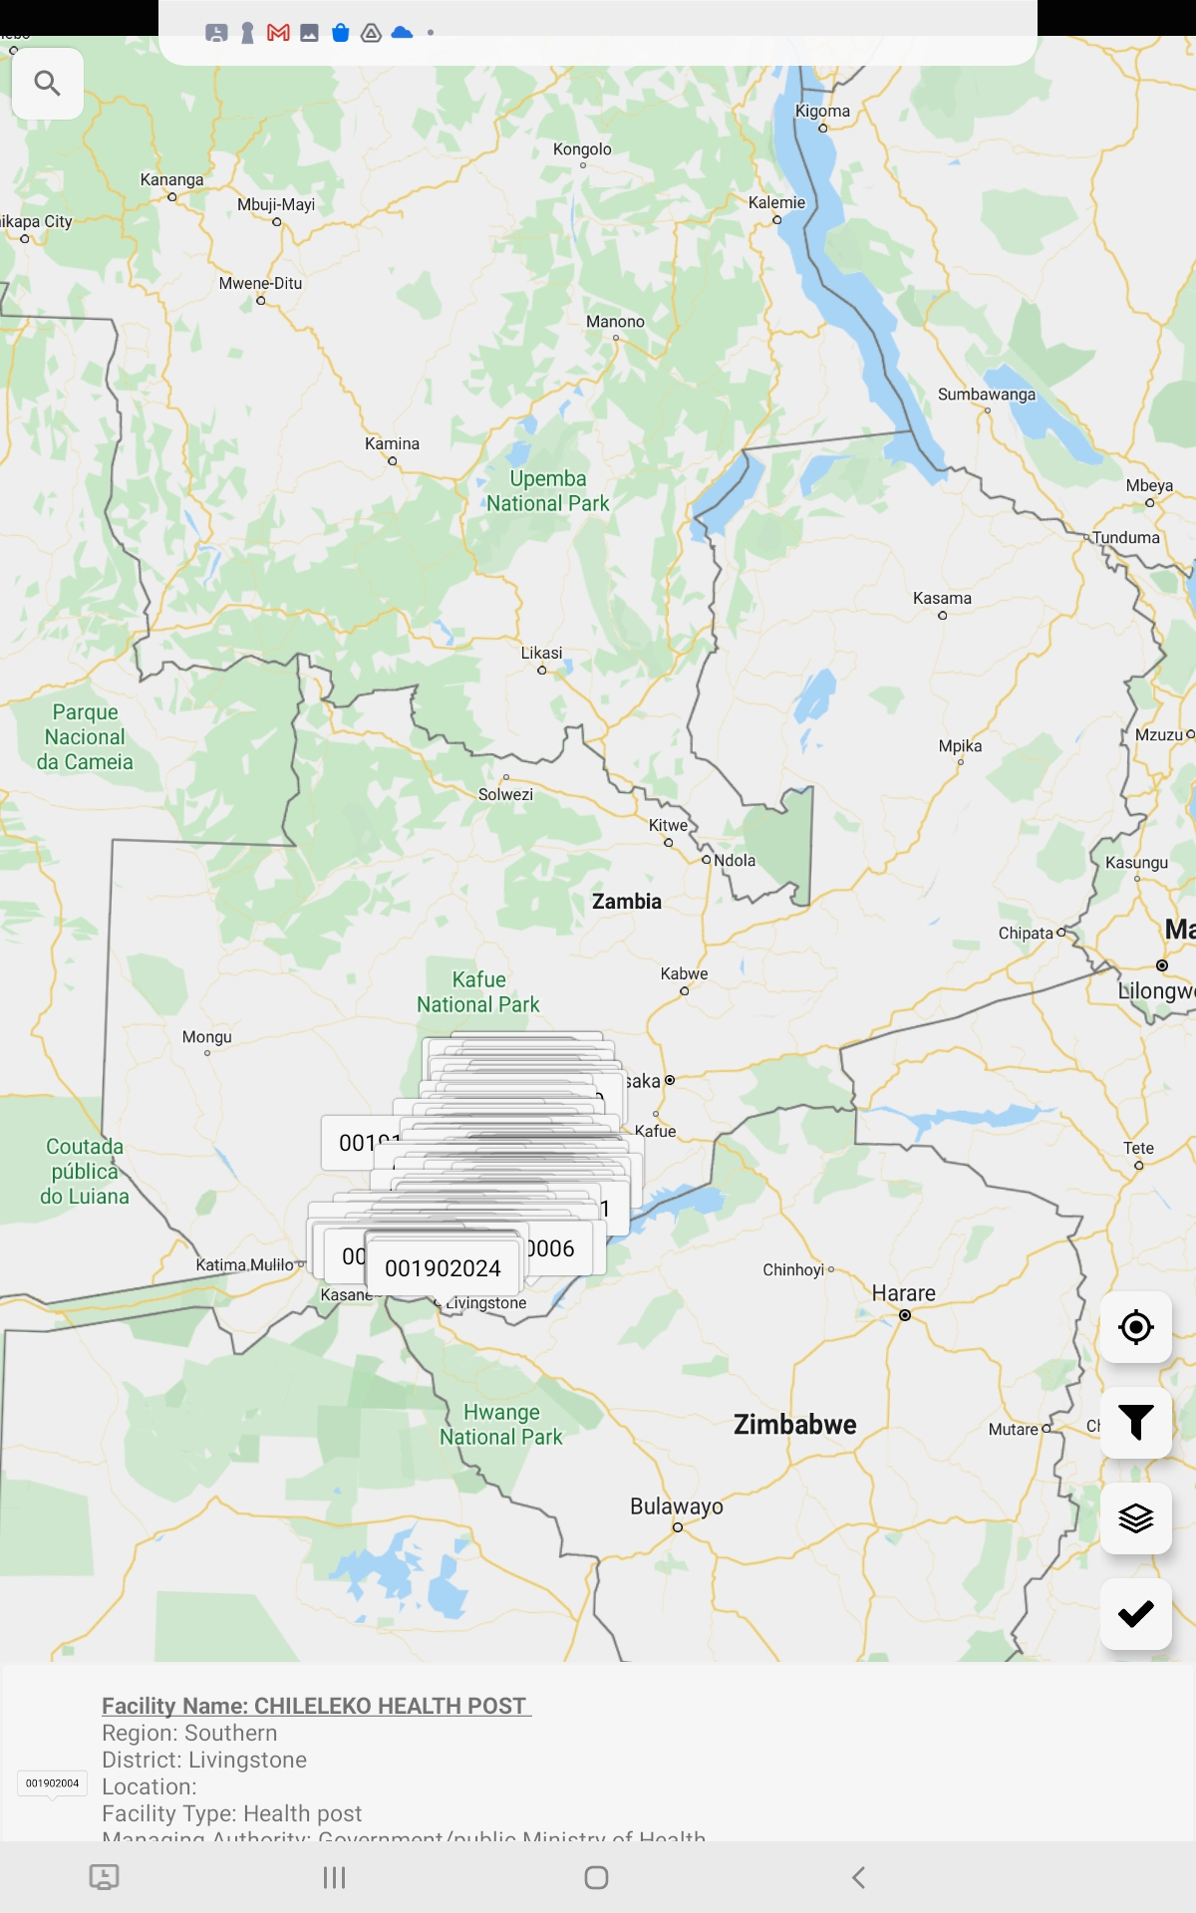
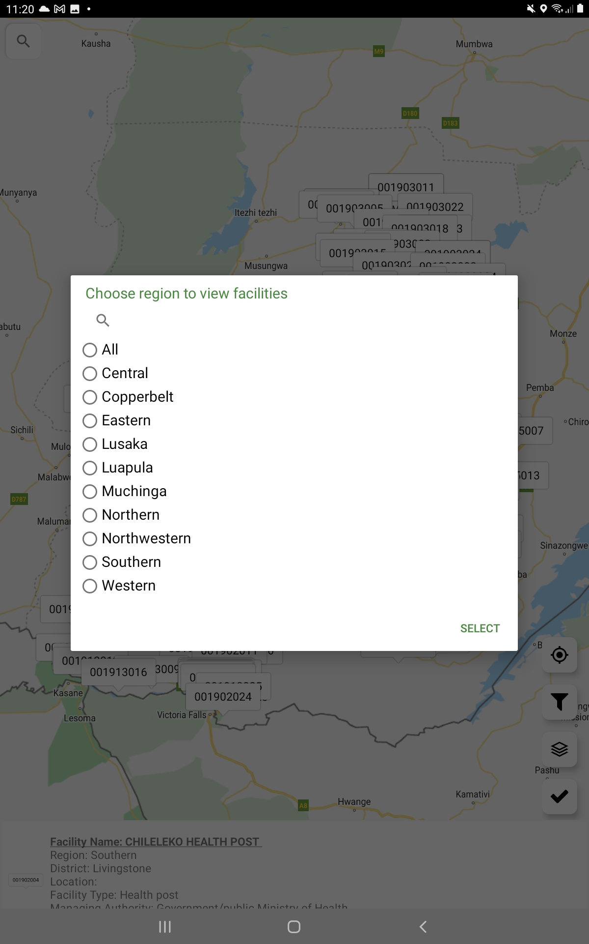
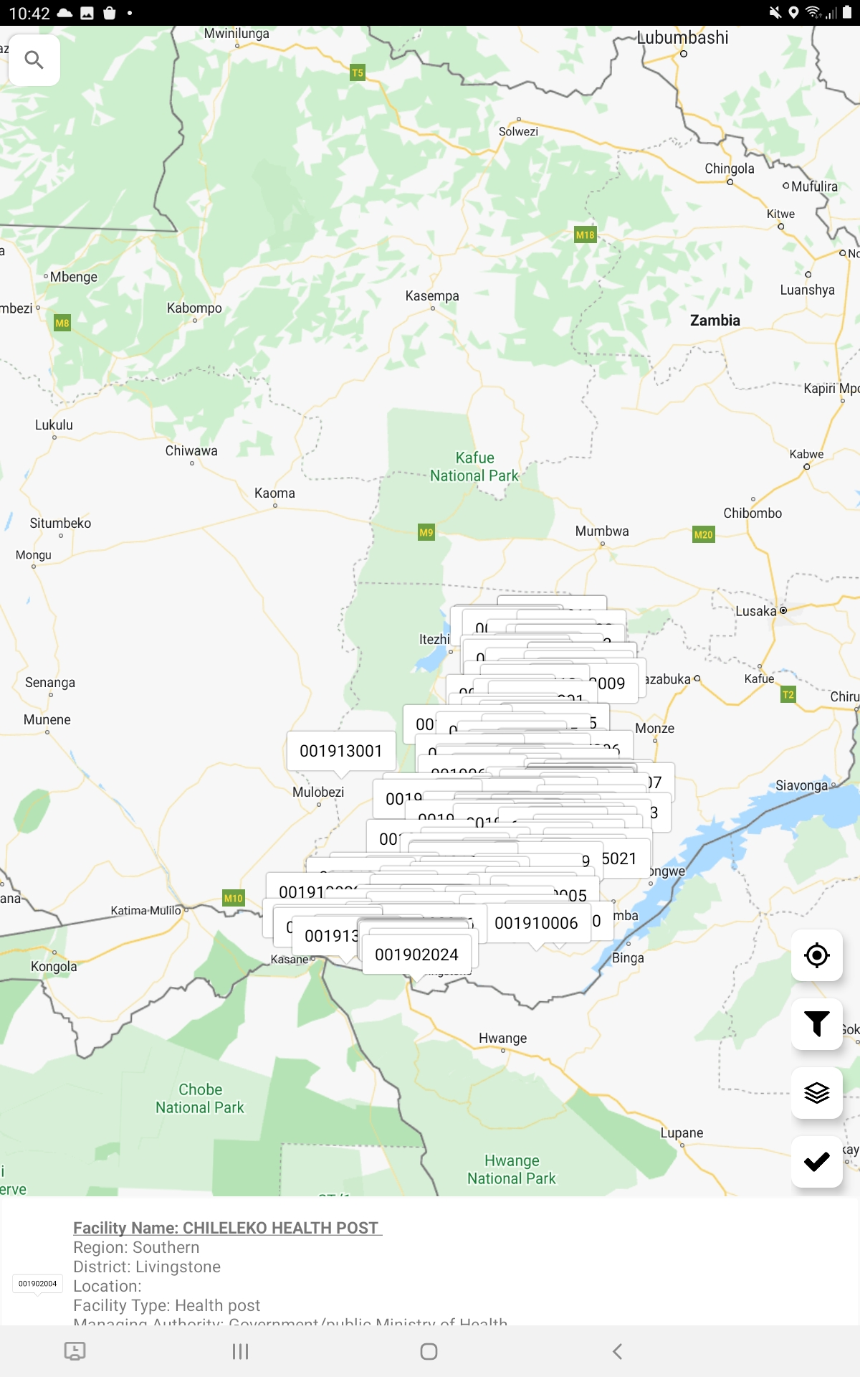
5. View reports
Facility coverage report – Map view
Click on the “filter” icon to only show facilities for a selected region and to zoom to that region
Select the region of interest
Map now shows only the facilities for that region
Notes:
Click on the “Filter” icon in the red box to zoom and show facilities for a selected region on the map. ​​
​
​After selecting the filter button, select the region of interest. ​​
​
The map now shows only the facilities for that region.​​
​
Use the Back button on the tablet to return to the supervisor menu.​
​

Slide 19
You have now completed Unit 7.
Now try the end of module quiz.
Notes:
You have now completed Unit 7.
Now try the end of module quiz.

